Slide 1
SHORT CASES IN SURGERY (1)
DR. ARKAPROVO ROY
ASSOCIATE PROFESRROR, SURGERY, MCH, KOLKATA
DERMOID CYST AND SEBACEOUS CYST

Slide 2
Dermoid cyst

Slide 3
DERMOID CYST
Cyst lined by squamous epithelium containing desquamated cells.
Contents: mixture of sweat, sebum, desquamated epithelial cells, hair.
Clinical types:
Congenital / sequestration dermoid
Implantation dermoid
Tubulodermoid
Teratodermoid

Slide 4
Congenital / sequestration dermoid
Site: along lines of embryonic fusion (midline of body or face)
Formation: dermal cells sequestrated in subcutaneous plane > proliferate & liquify > cyst > grows & indents mesoderm(future bone) > bony defects (indentation – pathognomonic)

Slide 5
Location:
Medial Nasal Dermoid Cyst (root of nose at fusion lines of frontal process),
External And Internal Angular Dermoid (fusion line of frontonasal and maxillary processes)
Sublingual Dermoid
Pre –Auricular Dermoid
Post Auricular Dermoid

Slide 6
External Angular Dermoid

Slide 7
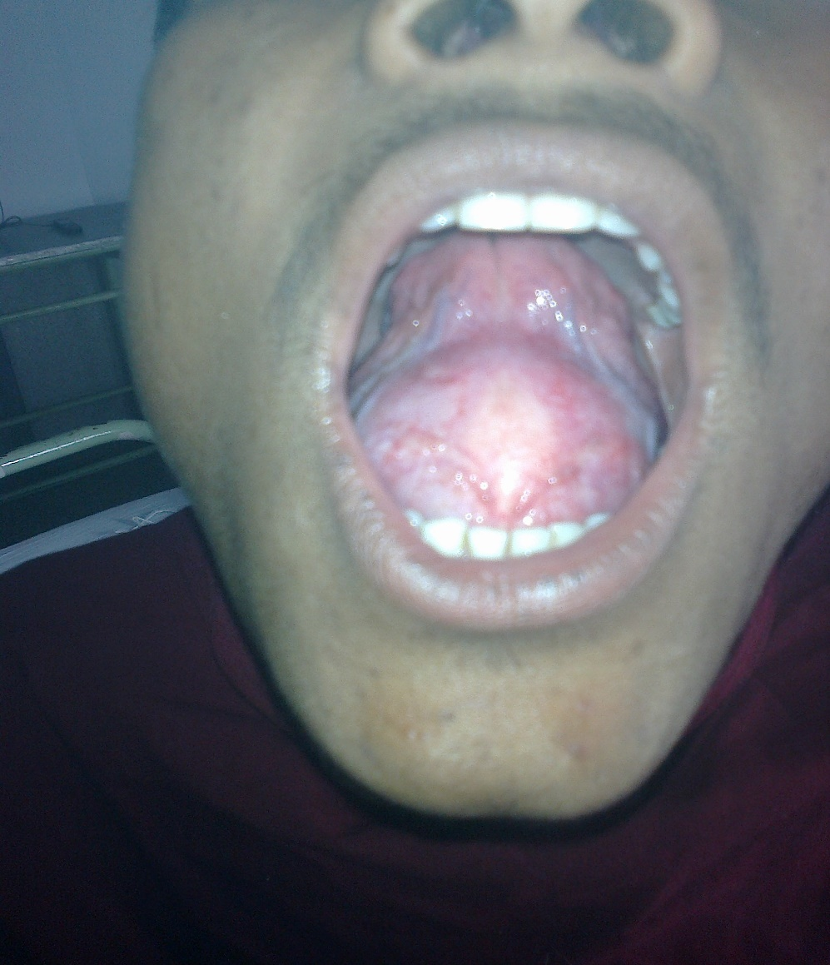
Sublingual dermoid

Slide 8
Clinical features
Manifests in childhood or adolescence
Typically a painless slow growing swelling
Soft, cystic, fluctuant, yield to pressure of finger and will not slip away
Transillumination test negative
Putty in consistency
No impulse on coughing
Underlying bony defect – clue to diagnosis
Location along line of fusion

Slide 9
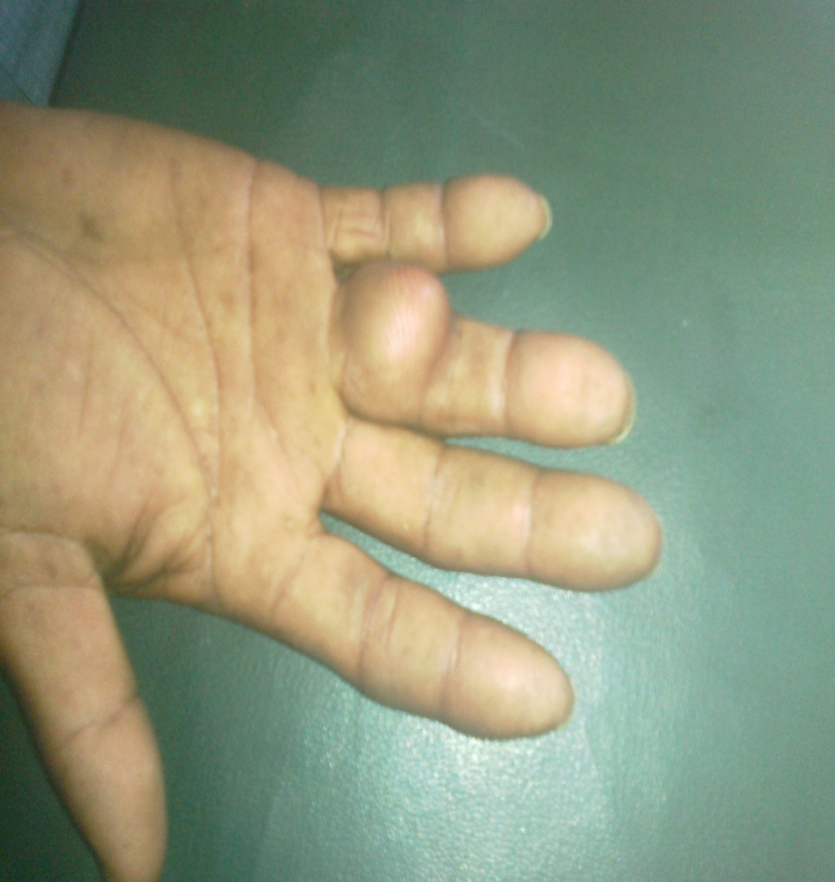
Other types
Implantation dermoid:
Found in women, tailors, agriculturists who sustain repeated minor injuries
Sharp injury- epidermal cells implanted in subcutaneous plane- dermoid cyst
Found in fingers, palm, sole of foot
Hard in consistency ( skin is thick).

Slide 10
Teratodermoid
Teratomatous dermoid:
Arise from totipotent cells > ectodermal, mesodermal, endodermal elements
Site - ovary, testis,retroperitoneum, mediastinum.

Slide 11
Tubulo-embryonic dermoid:
Arises from ectodermal tubes
Examples: thyroglossal cyst, post- anal dermoid

Slide 12
Thyroglossal cyst

Slide 13
Investigations:
Blood – TC, DC,Hb,ESR
Urine Examination
FNAC-
Ultrasonography- mass cystic/ solid
X ray- subjacent bone eroded by dermoid(in sequestration dermoid- if intra cranial extension seen -
CT scan- size , shape , local spread, extension

Slide 14
Treatment:
Excision of the cyst
Incision depends on the location
COMPLICATIONS:
Infection
Recurrence

Slide 15
Sebaceous cyst
Also known as Epidermal inclusion cysts or epidermal cysts
Presence of punctum is pathognomonic

Slide 16
They are common cutaneous lesions
Represents proliferation of squamous epithelium within a confined space in the dermis or subdermis.

Slide 17
Clinical presentation:
Epidermal cysts are either found incidentally or present as a firm non-tender lump.
If they rupture a local inflammatory response to the necrotic debris released can mimic infection.
Although they can be found anywhere, they are typically located on the scalp, face, neck, trunk, and back
Rarely they can be seen within bones representing an intraosseous epidermoid cyst.
Rarely epidermal cysts can undergo malignant degeneration with squamous cell carcinoma.
Not found over palm and sole.

Slide 18
Pathology:
They are thought to occur as a result of:
Traumatic/surgical implantation
Occlusion of the pilosebaceous unit
Congenital rests of cells
Human papillomavirus type 57 or 60 infections implicated palmoplantar epidermoid cysts

Slide 19
Investigations:
Blood – TC, DC,Hb,ESR
FNAC-
Ultrasonography- mass cystic/ solid

Slide 20
Treatment:
They are benign and generally do not require treatment.
If infected they may require incision and drainage.
If they continue to grow they require excision.
Complications:
Superimposed infection
Rupture
Concurrent occurrence of tumors within them, e.g. Melanoma (very rare)

