Slide 1
SHORT CASES IN SURGERY 2
DR. ARKAPROVO ROY
ASSOCIATE PROFESRROR, SURGERY, MCH, KOLKATA
LIPOMA AND HAEMANGIOMA

Slide 2
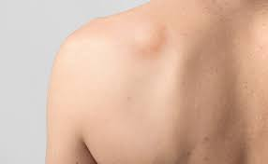
Lipoma

Slide 3
Introduction:
Commonest tumor of s/c tissue.
Benign
Arising from yellow fat
Universal tumor
Multiple lipomas- Dercum’s disease

Slide 4
Sites:
Location | Presentation | D.D. | Significance
s/c | Mobile, lobular, edge slips under palp.fingers | Neurofibroma | Most common variety
Subfascial | Diff. to appreciate edge & lobulation | Implantation dermoid , Tbtenosynovitis | In scalp- erodes bone
Subsynovial, intra-articular | Knee/elbow sweling | Bursa, Baker’s cyst | Intra-articular is rare
Intermuscular | Swelling | Fibrosarcoma Hematoma | More chance of devpg liposarcoma
Parosteal | Feels hard | Bony tumor | Very, very rare

Slide 5
Location | Presentation | D.D. | Significance
Submucus | Asymptomatic/ stridor | Intestinal/laryngeal tumor | Intussusception
Subserosal | Retroperitoneal swelling | Hydronephrosis, retroperitoneal cyst | Liposarcoma
Extradural | Very rare | - | -
Intraglandular | Breast, pancreas | Cystic lesions | Very rare
Parosteal | Feels hard | Bony tumor | Very, very rare

Slide 6
Histological type:
Fibrolipoma
Neurolipoma
Naevolipoma
Angiolipoma

Slide 7
Clinical features
They commonly occur in the neck, shoulders, back, abdomen, arms and thighs
Localized, lobular, non-tender
Semi-fluctuant
Mobile
Slip sign
Skin free
Pedunculated +/-

Slide 8
Warning signs:
Increasing in size or suddenly growing very quickly
Being painful
Becoming red or hot
Turning into a hard or immovable lump
Causing visible changes in the overlying skin

Slide 9
Investigations
Complete blood count
Sugar, Urea, Creatinine
PT, INR
CXR, ECG
F.N.A.C
Imaging:
USG
CT Scan
MRI

Slide 10
Treatment:
Excision and sent for HPE

Slide 11
Complication:
Myxomatous degeneration
Saponification
Calcification
Infection
Ulceration
Intussusception & intestinal obstruction
Malignant change – high risk for lesions over back and thigh

Slide 12
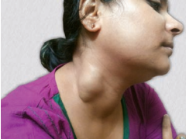
Haemangioma

Slide 13
What is your diagnosis?
Cavernous haemangioma
This is likely to be a cavernous hemangioma
Swelling is present for a long time and is gradually increasing in size
The swelling is raised from the surface of skin and there is bluish discoloration of the overlying skin
Feels soft and spongy
No pulsation over the swelling
The swelling is compressible

Slide 14
What are the common sites where cavernous hemangioma may be found?
It may be found in the subcutaneous tissues of the face, ear and lips
In the mucous membrane of tongue, mouth and lips
In the internal organs, such as liver, kidneys, intestine and brain

Slide 15
How will you demonstrate sign of compressibility?
The swelling is pressed with the fingers. In compressible swelling, the swelling will diminish in size or may disappear and the swelling reappears on release of pressure

Slide 16
How will you treat this patient?
In view of the clinical sign of compressibility, the swelling is likely to be a hemangioma. I would like to do a color Doppler study to confirm my diagnosis.
The color Doppler study will show the vascular lesion.
As the swelling is large,first give sclerosant injection and then plan for excision of the mass

Slide 17
How sclerotherapy is done?
Inject 1% polidocanol into the swelling once a week for 4–6 weeks

Slide 18
What other sclerosants are used?
Hypertonic saline, sodium tetradecyl sulfate and boiling water may also be used as sclerosant.

Slide 19
How sclerotherapy helps?
Small swelling: May disappear with sclerotherapy.
Large swelling: Size of the lesion may diminish due to fibrosis and destructions of vascular spaces. Resection becomes easier and bleeding during surgery is reduced.

Slide 20
What surgery will you do?
Excision of the swelling
Alternatively feeding vessels are ligated and the hemangiomatous mass is then excised
Bleeding may be controlled with diathermy or ligation

Slide 21
How else the hemangioma may be treated?
Laser beam therapy may be effective in small hemangiomas
Embolization of the feeding vessels may cause some regression of the mass rendering surgical excision easier

Slide 22
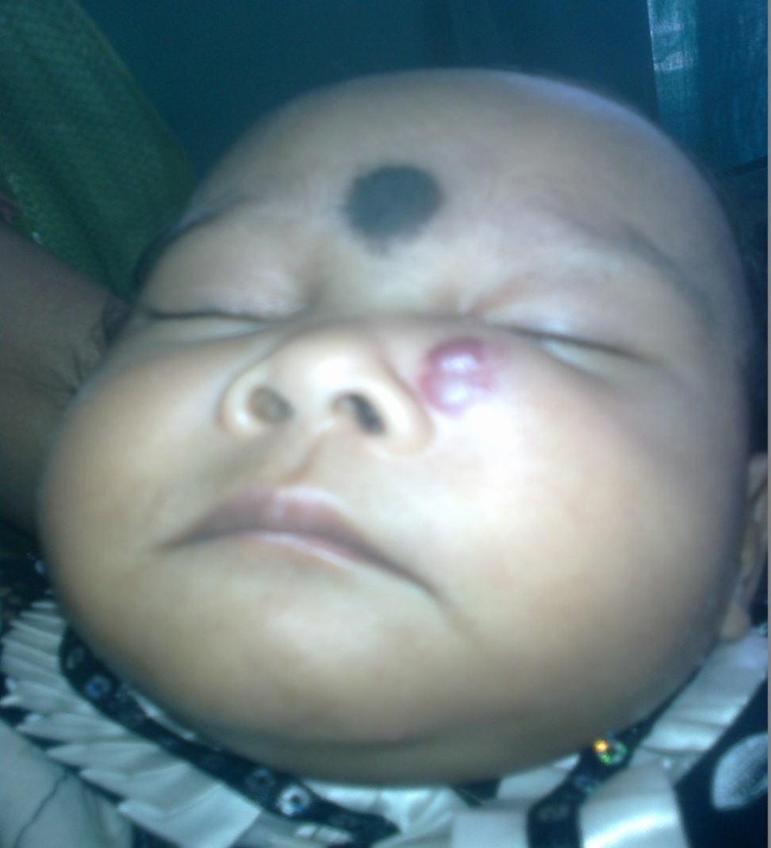
Haemangioma

Slide 23
What is your diagnosis?
Capillary haemangioma
Swelling is present for a long time
It is gradually increasing in size
The swelling is raised from the surface of skin
There is bluish discoloration of the overlying skin
No pulsation over the swelling
It is compressible

Slide 24
Define haemangioma
Hemangioma is a type of hamartoma arising from blood vessels. It is actually not a tumor.

Slide 25
What are the different types of hemangioma?
Depending on the nature of blood vessels involved, there are three types of hemangioma:
Capillary hemangioma
Cavernous hemangioma
Arterial or plexiform hemangioma

Slide 26
What are the different types of capillary haemangioma?
There are different types of capillary hemangiomas:
Salmon patch
Port wine stain
Strawberry angioma
Spider nevus

Slide 27
Salmon patch- This is a pigmented spot present at birth usually seen in the midline in the forehead or in the occipital region and usually disappears by 1 year.
Port wine stain:
Present since birth
Usually a deep red or purple discoloration situated in face, lip, cheek or neck
The color diminishes on pressure but reappears on release of pressure
The lesion does not show any change during the rest of life.

Slide 28
What are the characteristics of strawberry angioma?
A red pigmented lesion is usually noticed 1–3 weeks after birth and gradually increases in size for about a year forming a strawberry like swelling
Swelling is raised from the surface, surface is irregular and there may be small areas of ulceration, which is covered with scab
The swelling is soft, non-pulsatile and compressible
Strawberry angioma can occur in any part of the body but is commonly seen in head, face and neck
After 1 year, the swelling starts regressing and may involute by the age of 7–8 years
The lesion is composed of immature vascular tissue

Slide 29
How will you treat port wine stain?
May be left as such
Suitable cosmetics to mask the color
Laser therapy
Excision with skin grafting may be considered in selected case.

Slide 30
How will you treat strawberry angioma?
Wait and watch till 7–8 years of age for spontaneous involution to occur
Sclerosant injection may be tried
Cryosurgery by application of carbon dioxide snow
Laser therapy using carbon dioxide or Nd:YAG laser
Excision and skin grafting in selected cases

Slide 31
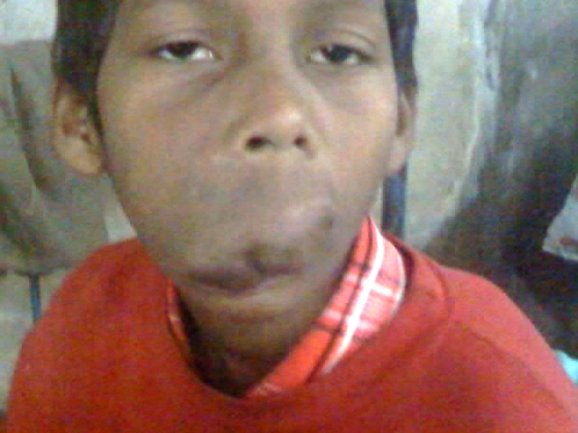
What is your diagnosis?
This is a condition of congenital arteriovenous fistula.
There is arterialization of veins.
The vein becomes dilated, tortuous, thickened and pulsatile
It can also found in limbs and scalp.
Local gigantism
Also known as plexiform haemangioma or cirsoid aneurysm
ARTERIOVENOUS MALFORMATION OF UPPER LIP

Slide 32
How will you treat this patient?
Ligation of feeding vessel and excision of the mass
Therapeutic embolization of feeding artery may help and may render the excision easier

Slide 33
What are the complications of hemangioma?
Hemorrhage
Thrombosis
Calcification
Ulceration of overlying skin
Pressure effects
Rarely malignant change
Infection

