Slide 1
SHORT CASES IN SURGERY 3
DR. ARKAPROVO ROY
ASSOCIATE PROFESRROR, SURGERY, MCH, KOLKATA
THYROGLOSSAL CYST AND CYSTIC HYGROMA

Slide 2
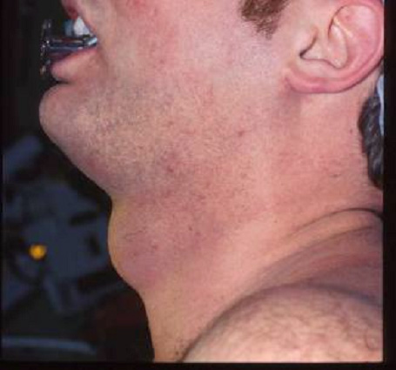
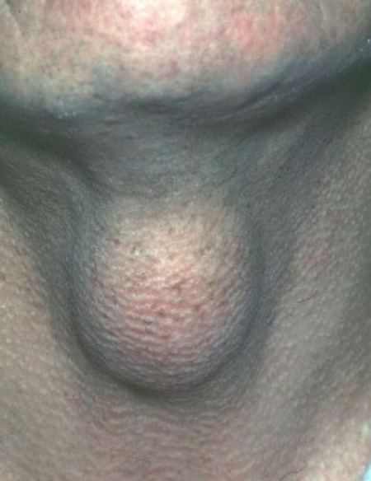

Slide 3
THYROGLOSSAL CYST
Thyroglossal cyst is a fluid-filled sac resulting from incomplete closure of the thyroglossal duct.

Slide 4
Anatomy:
The thyroglossal duct arises embryologically between the first and second pharyngeal pouches.
It runs as a hollow tube from the foramen caecum on the dorsal surface of the tongue, becoming a solid cord of cells migrating through the tongue and into the midline of the neck.
The tract usually passes in front of the hyoid bone and then loops up behind it before descending in the midline of the neck where the cells divide to form the two lobes of the thyroid gland either side of the midline.
The duct normally atrophies in the sixth week of gestation.

Slide 5
Clinical features:
Usually presents in children or young adults. | 75% appear in front of the hyoid bone and the majority of the rest at the level of the thyroid or cricoid cartilage of the larynx. | 5% become infected presenting as a painful, red neck swelling.
90% present as a painless midline cyst. | The cyst is mobile and moves up on swallowing and protrusion of tongue. | 15% have a fistula to the skin (due to infection or incomplete excision).
10% appear on one side of the midline, usually the left. | If large enough it will transilluminate. | Papillary carcinoma of the thyroglossal ductal cells is rare. Treatment is by excision.

Slide 6
Diagnosis and investigations:
CT scan - often reveal a well circumscribed cyst related to the midline of the hyoid bone.
Fine-needle aspiration may reveal a cloudy infected fluid or a straw-coloured fluid.

Slide 7
Treatment:
Infected thyroglossal cyst:
Majority respond to antibiotics.
Surgical drainage if abscess formed or failure to respond to antibiotics.
Elective excision of the cyst once acute infection has resolved.

Slide 8
Surgery:
Excision is recommended for most cysts.
Remove through a transverse midline incision in a skin crease.
Divide the platysma muscle and dissect the cyst out bluntly.
On the deep surface it will be found to be attached to the hyoid bone: excise approximately 1cm of the bone, removing any underlying thyroglossal duct epithelium.
Close the wound in layers with a suction drain.
If there is a fistula or sinus in the neck excise it through a transverse elliptical incision. Again use blunt dissection and remove the middle part of the hyoid bone (Sistruck procedure).

Slide 9
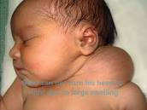
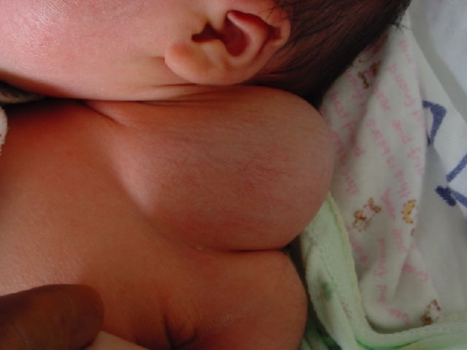
CYSTIC HYGROMA

Slide 10
Embryology:
A cystic hygroma is a cyst, or a group of cysts, found mostly in the neck.
They are caused by an error in the development of lymph sacs and lymph vessels as the baby develops during pregnancy.
By the end of the fifth week of pregnancy, the baby's lymphatic tissues form as lymph sacs.

Slide 11
Cystic hygromas are found predominantly in the neck and are usually noted at birth or soon thereafter.
Anatomy: They are more common in the posterior triangle.
They may reach up into the cheek or parotid region and down into the mediastinum or axilla.
Large masses extend past the sternocleidomastoid muscle into the anterior compartment and may cross the midline.
They may involve the floor of the mouth and the base of the tongue.

Slide 12
Symptoms and signs:
Difficulty in nursing
Facial or neck distortion
Respiratory distress
Brachial plexus compression with pain or hyperesthesia
A sudden increase in size secondary to spontaneous hemorrhage, which can be fatal

Slide 13
Characteristics:
There is no predilection for either sex or for either side of the body.
The hygromas can be progressive, static, or regressive.
Small lesions are unilocular and firm.
Large tumors are loculated, shiftable, and compressible.
The hygromas generally transilluminate.
The cyst walls are usually tense, and because the loculi tend to communicate, rupture of one locule can cause all of them to partially collapse.

Slide 14
Investigations:
Antenatal ultrasound -
On prenatal ultrasound, they may present as a nuchal cyst and may show septations +/- evidence of fetal anasarca /hydrops fetalis. The presence of septations may indicate a poorer outcome.
Compared to nuchal translucency, It has a higher risk for aneuploidy (5-fold), cardiac anomalies (12-fold) and fetal demise (6-fold)
CT -
Commonly seen as a hypoattenuating ill-defined neck cystic mass.

Slide 15
Treatment: Surgery is the mainstay of treatment.
Recurrences are common because the cysts insinuate themselves into adjacent structures, so resection is often incomplete.
The greater the lymphangiomatous component of a hygroma, the more likely it is to recur.
Oral and perioral lymphangiomas are relatively common lesions that are usually found at birth or soon thereafter. They behave very much like cystic hygromas.

