Slide 1
SHORT CASES IN SURGERY (4)
DR. ARKAPROVO ROY
ASSOCIATE PROFESRROR, SURGERY, MCH, KOLKATA
EPIGASTRIC, PARAUMBILICAL AND UMBILICAL HERNIA

Slide 2
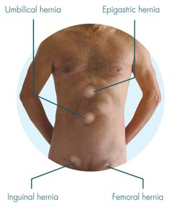

Slide 3
EPIGASTRIC HERNIA
Introduction:
These arise through the midline raphe (linea alba) anywhere between the xiphoid process and the umbilicus, usually midway. When close to the umbilicus they are called supraumbilical hernias.
Epigastric hernias begin with a transverse split in the midline raphe.
The defect is elliptical.
It has been hypothesised that the defect occurs at the site where small blood vessels pierce the linea alba or, more likely, that it arises at weaknesses due to abnormal decussation of aponeurotic fibres related to heavy physical activity.

Slide 4
Epigastric hernia defects are usually less than 1 cm in maximum diameter and commonly contain only extraperitoneal fat which gradually enlarges, spreading in the subcutaneous plane to resemble the shape of a mushroom.
When very large they may contain a peritoneal sac but rarely any bowel.
More than one hernia may be present.

Slide 5
Aetiology:
Incidence 1-5%
Men> women
20% multiple
The primary risk factors are obesity and pregnancy

Slide 6
Clinical features:
The patients are often fit, healthy males between 25 and 40 years of age.
These hernias can be very painful even when the swelling is the size of a pea due to the fatty contents becoming nipped sufficiently to produce partial strangulation.
The pain may mimic that of a peptic ulcer but symptoms should not be ascribed to the hernia until gastrointestinal pathology has been excluded.

Slide 7
A soft midline swelling can often be felt more easily than it can be seen.
It may be locally tender.
It is unlikely to be reducible because of the narrow neck.
It may resemble a lipoma.
A cough impulse may or may not be felt.

Slide 8
Treatment:
Very small epigastric hernias have been known to disappear spontaneously, probably due to infarction of the fat.
Small to moderate-sized hernias without a peritoneal sac are not inherently dangerous and surgery should only be offered if the hernia is sufficiently symptomatic.

Slide 9
Operation:
This may be done by open or laparoscopic surgery.
The most common cause of ‘recurrence’ is failure to identify a second defect at the time of original repair.

Slide 10
PARAUMBILICAL AND UMBILICAL HERNIA

Slide 11
PARAUMBILICAL HERNIA
Introduction:
A paraumbilical hernia is a protrusion of the abdominal contents, including mesenteric fat or bowel, through a weak point of the muscles or ligaments near the navel.
It discomforts when fatty tissue gets trapped and a lump can be felt or seen.

Slide 12
Clinical features:
Occurs commonly in adults, common in females.
It enlarges ovally, often attains a large size and sags downwards.
Swelling which has smooth surface, distinct edges, soft, resonant with dragging pain and impulse on coughing.
Neck of sac is relatively narrow, got tendency to go for adhesion, irreducibility and obstruction.

Slide 13
Treatment:
Is always surgery – should be done as early as possible – as the hernia is prone to develop obstruction and subsequently strangulation.
Dissection of hernia sac and placement of mesh in retro-rectus plane and under the umbilicus is the ideal treatment

Slide 14
Often umbilectomy is required and also mesh placement is beneficial (when defect>4cm in size)
Mayo’s operation – double breasting.
If there is strangulation, resection of bowel segment and anastomosis is done followed by repair of the hernia.

Slide 15
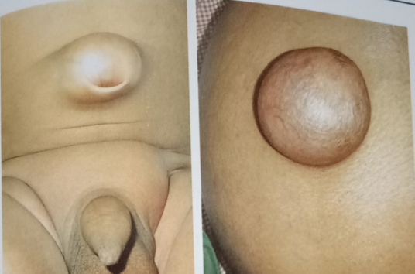
UMBILICAL HERNIA
Introduction:
Umbilical hernia develops due to either absence of umbilical fascia or incomplete closure of umbilical defect.
Weakest part is in the umbilical cicatrix is upper part where hernia begins.

Slide 16
Clinical features:
Small, centrally placed within the umbilicus.
Often contains pre-peritoneal fat and rarely contains bowel/omentum.
May be painful but rarely strangulates.

Slide 17
Investigations:
The diagnosis is rarely in doubt.
If there is concern that a palpable lump may be a lipoma or subcutaneous tissue growth then a CT scan can usually confirm the diagnosis.

Slide 18
Treatment:
Initially conservative.
In 93 to 95% cases, it disappear spontaneously in few months after birth.
Surgery.

Slide 19
Indications of Surgery:
Without any complication – can wait up to 4 years.
If remains irreducible or enlarges in size - after the age of two years
If the defect is more than 2 cm in size
Acquired/adult hernia

Slide 20
Principles of repair:
Identify edges of hernial sac and reduce hernia.
Small defects are usually repaired by an overlapping suture repair using non-absorbable suture, e.g.Prolene, without reinforcements.
Larger defects or recurrent hernias may be repaired with mesh (usually polypropylene based, e.g. Prolene), which is usually placed on top of the fascial layers.

Slide 21
Types of Surgery:
Primary closure of the defect.
Preperitoneal/Retrorectus/Sublay mesh repair> 4 cm size defect
Umbilectomy
Open dual PTFE and polypropylene mesh replacement
Laparoscopic umbilical hernia repair(IPOM/IPOM Plus)

