Slide 1
VARICOSE VEINS
DR. ARKAPROVO ROY
ASSOCIATE PROFESSOR SURGERY
MEDICAL COLLEGE KOLKATA

Slide 2
DEFINITIONS/TERMINOLOGIES
ANATOMY
PHYSIOLOGY
PATHOPHYSIOLOGY
DEFINITIONS
CLINICAL FEATURES
INVESTIGATIONS
TREATMENT
RECENT ADVANCES
VENOUS ULCER

Slide 3
Few terminologies for dilated veins
1. Telangiectasia:- Means a confluence of dilated intradermal venules of <1 mm in diameter.
2. Reticular veins:- Dilated subdermal veins of 1-3 mm in diameter.
3. Ankle flare:- Dilated group of reticular veins near medial malleolus.
4. Blow out:- A localised dilatation of vein which is dome like or ballooned out.
5. Saphena varix:- Dilated long saphenous vein near saphenofemoral junction
6. Atrophic blanche:- Atrophic skin with pigmentation and reticular veins – seen in ankle regions.
7. Spider veins:- Spider veins are smaller and thinner than varicose veins and usually appear on the face or legs.

Slide 4
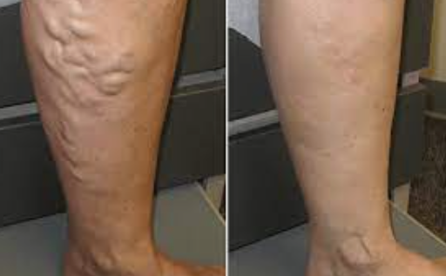
Varicose veins
Varicose veins are defined as superficial veins, which permanently have lost its valvular efficiency, and as a product of the resultant venous hypertension in the standing position become dilated,tortuous and thickened.
Venous insufficiency is a condition of inadequate venous return and hypertension when the patient is
in an upright position.

Slide 5
ANATOMY
Fascia, Veins and Cutaneous nerves of the Lower limb:
The subcutaneous tissue of the hip & thigh is continuous with that of the inferior abdominal wall and buttock.
At the knee the subcutaneous tissue loses its fat and blends with the deep fascia.
Deep fascia: strong & inelastic it invests the LE; it limits outward expansion of the contracting musculature, the increased pressure “pumps” the blood proximally through the veins.

Slide 6
Deep fascia of the thigh (fascia lata)
The fascia lata attaches to and is continuous with:
1.The inguinal ligament, pubic arch, body of the pubis and pubic tubercle.
2.Scarpa’s fascia of the inferior abdominal wall attaches to deep LE fascia inferior to the inguinal ligament.
3. Iliac crest (lateral & posterior).
4. Sacrum, coccyx, sacrotuberous ligament, ischial tuberosity postreiorly.
5. Exposed parts of bones at the knee & deep fascia of the leg.

Slide 7
Surgical anatomy of venous system of lower limb:
Divided into three systems:-
1. Superficial venous system
2. Perforators
3. Deep venous system

Slide 8
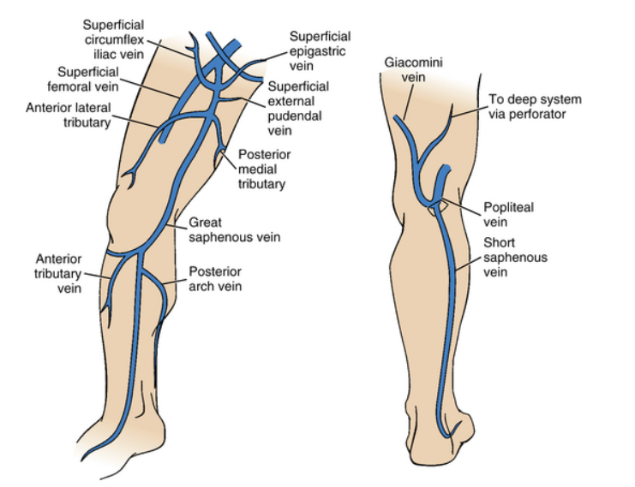
SUPERFICIAL VENOUS SYSTEM
Great saphenous vein– formed by the union of the dorsal digital vein of the great toe and the dorsal venous arch.
Ascends anterior to the medial malleolus, posterior to the medial condyle of the femur. It freely communicates with the small saphenous vein.
Proximally it traverses the saphenous opening in the fascia to enter the femoral vein.
Saphenous opening NAVEL
This is a gap in the fascia lata infero-lateral to the inguinal ligament, lateral to the pubic tubercle.
Medial margin is smooth
Lateral margin is sharp forming the falciform ligament
Cribiform fossa – a sleeve like membrane covering the saphenous opening
Short saphenous vein- Formed by the union of the dorsal digital vein of the 5th digit and distal venous arch.
Runs posterior to the lateral malleolus, lateral to the calcaneal tendon.
Runs superiorly medial to the fibula and penetrates the deep fascia of the popliteal fossa, ascends between the heads of the gastrocnemius muscle to join the popliteal vein.

Slide 9
In the thigh before entering in the saphenous opening it recieves
1. Anterolateral vein
2. Posteromedial vein of thigh
3. Superficial external pudendal vein
4. Superficial epigastric vein
5. Superficial circumflex iliac vein
6. Deep External Pudendal Vein
Tributaries of LSV and communication
Just below knee LSV receive posterior arch vein (Leonardo's vein) which collect the blood from postmedial aspect of calf .
Anterior veins of leg(stocking vein) ascend across the shin and join either LSV or posterior arch vein .
There is a free anastomosis b/w tributaries of short saphenous vein and venous arch connecting medial ankle perforating vein and this medial ankle perforating veins are connected with LSV in lower third of leg
In the lower third of thigh long saphenous vein connect with femoral vein in hunter’s canal by long perforating vein ( hunterian perforator)

Slide 10
Structures accompanying the SSV:
Sural nerve in lower third of leg
Lymphatic trunk which drains lateral aspect of foot and drain in the popliteal lymph nodes
Where the vein passes through fascia Posterior cuteneous nerve emerges out from deep to superficial.
In the upper part of vein it communicates with LSV via the posteromedial vein of Leg.
SSV may run above the popliteal space and end in deep veins in lower thigh or may end in LSV in upper thigh

Slide 11
PERFORATORS
Penetrate the deep fascia, tributaries of the saphenous veins, valves are located just distal to penetration of the deep fascia.
Veins cross the deep fascia obliquely
Muscle contraction causes the valves to close prior to venous compression so blood is forced proximally (musculo-venous pump).
Indirect perforating veins:
These consist of small superficial veins which penetrate the deep fascia to connect with vessel in muscle and in turn end in Deep vein.
Direct perforating veins :
These directly connect superficial veins with deep veins.

Slide 12
Direct perforator
In thigh : Adductor canal perforator connects long saphenous with femoral vein in lower part of adductor canal(hunterian’s perforator)
In the lower thigh on medial aspect Long SV connect femoral vein via DODD’s Perforator
Below knee : Perforator connects long SV or post-Arch vein with posterior tibial vein knows as BOYD’S Perforator.

Slide 13
In leg :
1.Lateral perforator is presented at the junction of mid & lower third of leg .It connect SSV with peroneal vein.
2. Medially there are three perforator which connect posterior arch vein with posterior tibial vein , know as COCKETT’S Perforator.
Upper medial perforator lies at the junction of middle and lower third of leg.
Middle medial perforator lies 4Inch above the medial malleolus .
Lower medial perforator lies posterio-inferior to the medial malleolus.

Slide 14
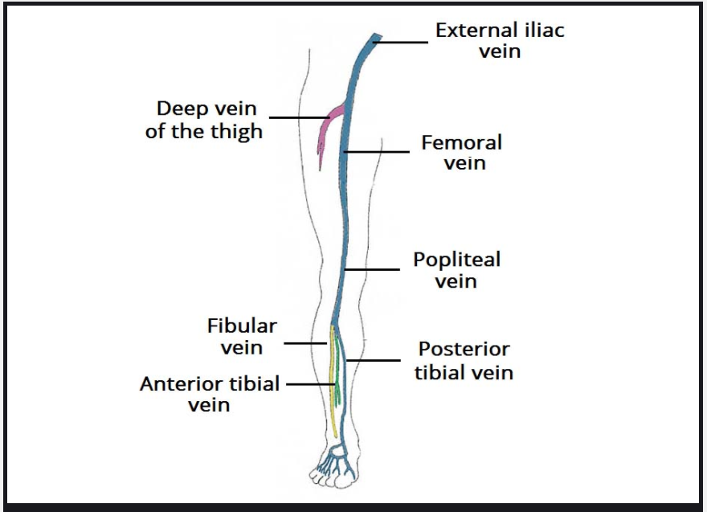
Deep venous system
Femoral vein
Popliteal vein
Anterior and posterior tibial vein
Peroneal vein
Usually paired with named arteries inside a vascular sheath, this allows arterial pulsation to force blood proximally.
The popliteal vein joins the femoral vein in the popliteal fossa
Femoral vein is joined by the deep vein of the thigh. The femoral vein passes deep to the inguinal ligament to become the external iliac vein.

Slide 16
Venous valves

Slide 17
Lymphatic drainage of Lower limb
Superficial Lymphatics:
Superficial lymphatic vessels accompany the saphenous veins (great & small)
Superficial lymphatics end at the superficial inguinal nodes most of this lymph drains to the external iliac nodes, some drains to the deep inguinal nodes.
Small lymphatics drain to the popliteal nodes
Deep Lymphatics:
Deep lymphatics drain to the popliteal nodes which then drain to the inguinal nodes then to the external iliac nodes.
Both deep & superficial drain into the lumbar lymphatics.

Slide 18
Surgical physiology of venous drainage
Blood is returned to the heart from the lower limbs against gravity and it is helped by following mechanisms:-
Calf muscle pump- It is the alternate contraction and relaxation of the muscles of leg which pushes blood against gravity. The pressure within the calf compartment rises to 200-300 mmHg during walking or exercise.
Competent valves – which are unidirectional . Only allows the blood to flow from superficial to deep system and towards heart.

Slide 19
Ambulatory Venous Pressure
When standing motionless, with venous valves in the neutral position, the pressure in the veins of the foot gradually increases until it equals the hydrostatic pressure developed by the column of blood stretching between the foot and the heart; in a person of average height, perhaps 90 mmHg. With active movement, the muscle pumps and valves come into play and the venous column is divided into several smaller columns, each at a lower pressure.
As a result, the pressure in the foot veins falls in health to less than 25 mmHg upon walking – the ambulatory venous pressure (AVP). Patients with muscle pump and/or venous valve failure, and/or venous outflow obstruction, demonstrate a raised AVP. Such sustained venous hypertension is the main factor contributing to the development of skin changes.

Slide 20
Venous Recirculation
In patients with varicose veins there is often a recirculation of venous blood within the leg. During calf relaxation, abnormally large volumes of blood enter the muscle pump from the superficial varices. (increased preload).
The muscle pump expels blood from the leg only for it to re-enter the leg by refluxing down superficial varices (akin to aortic regurgitation).
This blood then re-enters the muscle pump through perforating veins in the lower calf and so on.

Slide 21
By far the most powerful force propelling venous return flow is the musculo venous pumping mechanism, which can handle large volumes rapidly and generate a force well in excess of that required for venous return against gravity.
When the limb is in the dependent position, a normal set of valves in the deep and superficial veins will prevent reflux of blood against the normal direction of venous flow.
Failure of competence in the venous valves at saphenofemoral and saphenopopliteal junction will lead to retrograde flow down the limb when the patient stands up or after exercise movement has resulted in slack veins in the lower part of the leg. In the superficial veins, this is the basis of the most common venous disorder – simple varicose veins.

Slide 22
Pathophysiology
The pathophysiology behind their formation is complicated and involves the concept of ambulatory venous hypertension.
In healthy veins, the flow of venous blood is through the superficial system into the deep system and up the leg and toward the heart. One-way venous valves are found in both systems and the perforating veins.
Incompetence in any of these valves can lead to a disruption in the unidirectional flow of blood toward the heart and result in ambulatory venous hypertension (AVH).
Incompetence in the superficial venous system alone usually results from failure at valves located at the SFJ and SPJ.
The gravitational weight of the column of blood along the length of the vein creates hydrostatic pressure, which is worse at the more distal aspect of the length of vein.

Slide 23
Reflux at or near the SFJ does not always come through the terminal valve of the GSV, nor does it always involve the entire trunk of the GSV.
Reflux can enter the GSV below the sub terminal valve or even immediately below the junction, passing through a failed sub terminal valve to mimic true SFJ incompetence.
Reflux can also pass directly into any of the other veins that join the GSV at that level, or it may pass a few centimeters along the GSV and then abandon the GSV for another branch vessel.

Slide 24
Incompetence of the perforating veins leads to hydrodynamic pressure. The calf pump mechanism helps to empty the deep venous system, but if perforating vein valves fail, then the pressure generated in the deep venous system by the calf pump mechanism are transmitted into the superficial system via the incompetent perforating veins.
Once venous hypertension is present, the venous dysfunction continues to worsen through a vicious circle. Pooled blood and venous hypertension leads to venous dilatation, which then causes greater valvular insufficiency.

Slide 25
Over time, with more local dilatation, other adjacent valves sequentially fail, and after a series of valves has failed, the entire superficial venous system is incompetent. This can then cause subsequent perforator and deep venous valvular dysfunction.
The clinical findings of varicose veins, reticular veins, and telangiectasias are due to the hypertension in the superficial venous system that spreads to collateral veins and tributary veins, causing dilated tortuous structures.
In contrast to the superficial veins, the deep veins do not become excessively distended. They can withstand the increased pressure because of their construction and the confining fascia.

Slide 26
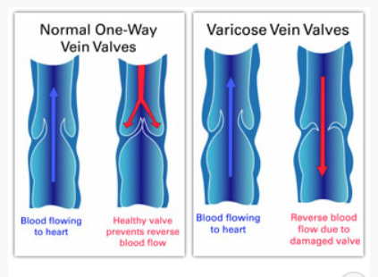
PATHOPHYSIOLOGY
Reflux of blood into
superficial veins due to
valve incompetence
venous hypertension in
Superficial veins
superficial veins become dilated,
tortuous and elongated

Slide 27
PRIMARY VARICOSE VEINS
No obvious cause could be found to explain varicosity.
They may occur as a result of congenital weakness in the vein wall due to defective connective tissue and smooth muscle or due to congenital absence/abnormality of valves.
Klippel-Feil-Trenaunay syndrome- congenital anomaly where superficial and deep veins do not have any valves, also called valveless syndrome.
Kasabach-Merritt syndrome is characterised by the combination of rapidly growing vascular tumour, thrombocytopenia, microangiopathic haemolytic anaemia and consumptive coagulopathy. The blood clotting disorder results from platelets and other clotting factors of the blood being used up within the tumor.
Primary varicosity can also be genetic. Some patients inherit abnormalities in FOXC2 gene.
These factors in addition to prolonged standing ( traffic police, hotel workers etc.) contribute to the development of varicose veins.

Slide 28
Primary varicose veins:
(95%) are caused by an increase in venous pressure in the superficial veins of the leg due to damage to the venous valves between the deep and superficial venous systems.
This increase may be at:
1. the sapheno-femoral junction between the long saphenous vein and the common femoral vein in the groin
2. the sapheno-popliteal junction between the short saphenous vein and the popliteal vein in the popliteal fossa
3. other sites (when they are known as perforators).

Slide 29
SECONDARY VARICOSE VEINS
Secondary varicose veins (5%) occur when the increased venous pressure in the superficial venous system is due to a disturbance in venous blood flow elsewhere, for example in:
1. Pelvic thrombosis /Obstruction to deep veins by pelvic mass
2. Extensive thrombosis of the veins in the leg (post phlebitis limb).
3. Deep vein thrombosis
4. Arterioveonus malformations (congenital or acquired as a result of a fracture).
5. Pregnancy
6. IVC thrombosis
Secondary varicose veins are invariably associated with venous hypertension in deep venous system with secondary involvement of superficial venous system.

Slide 30
Risk factors:
Age: Aging causes wear and tear. Eventually, that wear causes the valves to malfunction.
Sex: Women > Men. Hormonal changes during pregnancy or menopause. Progesterone relaxes venous walls. HRT / OCP may increase the risk of varicose veins.
Genetics
Obesity: Increases venous HTN.
Standing for long periods of time. Prolonged immobile standing impairs venous return.

Slide 31
Classification (CEAP)of chronic lower extremity venous diseases

Slide 32
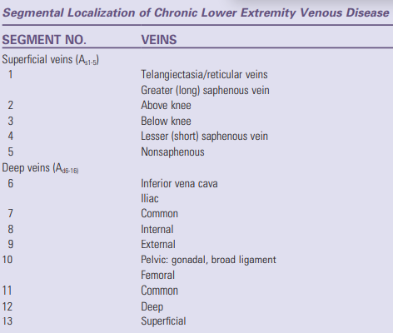
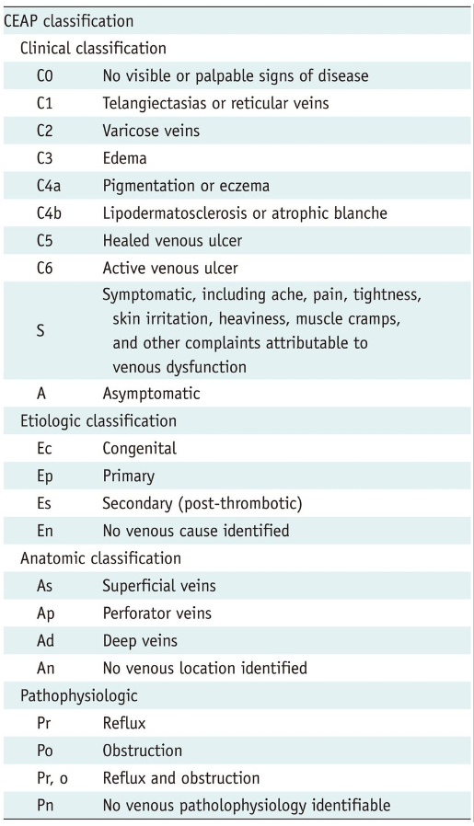

Slide 33
Clinical features
Symptoms:
Unsightliness:
Many patients with varicose veins complain of the unsightliness produced by tortuous dilated veins in their lower limbs.
Massive varicosities in men often cause few symptoms while minor varicosities in women may be the source of major concern.
Aches and pains:
Diffuse dull ache felt throughout the leg, which gets worse as the day passes and is exacerbated by prolonged standing.
Relief of the discomfort by wearing a elastic stocking provides good circumstantial evidence that the pain is of venous origin.
History of bursting pain during exercise (venous claudication) may indicate venous outflow obstruction.
Ankle edema:
Not a common or prominent feature of varicose veins.
Usually mild and only become noticeable at the end of the day.’
Other causes of edema, such as deep vein obstruction or lymphatic obstruction, must be excluded if there is marked edema and the patient complains of swelling of the lower leg as well as ankle.
Superficial thrombophlebitis
Hemorrhage
Pruritus, Eczema, pigmentation, lipodermatosclerosis and ulceration

Slide 34
Complications:
Extremely painful ulcers may form on the skin near varicose veins, particularly near the ankles
Brownish pigmentation usually precedes the development of an ulcer
Occasionally, veins deep become enlarged
Bleeding
Superficial thrombophlebitis
Equinus deformity

Slide 35
INVESTIGATIONS
Diagnosis:
The following are the most useful modalities available for venous imaging:
Contrast venography
MRI
Color-flow duplex ultrasonography

Slide 36
Duplex ultrasonography is the standard imaging modality for diagnosis of varicose insufficiency syndromes and for treatment planning and preoperative mapping
For complex cases, the following physiologic tests of venous function may reveal more information
Venous refilling time (VRT) – Results correlate with severity of venous insufficiency and reflux
Maximum venous outflow (MVO) – Detects obstruction to venous outflow from the lower leg, regardless of cause
Calf muscle pump ejection fraction (MPEF) – Detects failure of the calf muscle pump to expel blood from the lower leg

Slide 37
Management
The following are the modern techniques used to ablate varicosities:
Sclerotherapy – The most widely used medical procedure for varicose veins and spider veins
Laser and intense-pulsed-light therapy
Radiofrequency (RF) or laser ablation
Ambulatory phlebectomy

Slide 38
Common surgical approaches to large-vein varicose disease include the following:
Ligation of the sapheno-femoral junction with vein stripping
Phlebectomy performed through micro-incisions
Endovenous RF thermal ablation
Endovenous laser thermal ablation

Slide 39
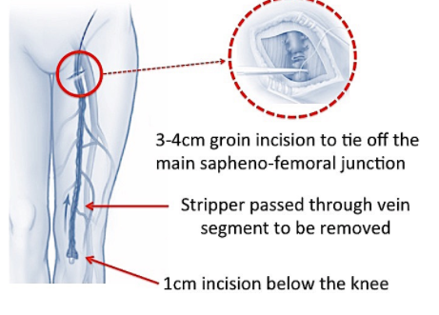
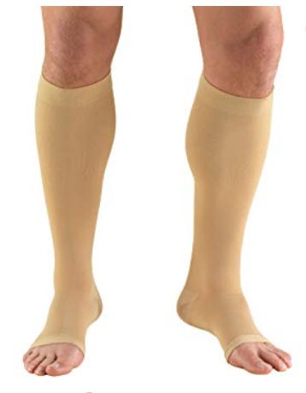
OLD MODALITIES OF MANAGEMENTS
1. Elastic compression stockings and foot end elevation during rest
Indications- pregnancy, pelvic tumour, DVT, A V fistula
Fundamental steps in treating varicose veins . 20-30 mm Hg stockings are sufficient.
2. Trendelenburg’s operation - Juxtafemoral flush ligation with stripping of vein by Metallic stripper .

Slide 40
MEDICAL AGENTS
Micronized purified flavonoid fraction:- (MPFF) (Daflon 500mg) Consists of 90% micronized diosmin and 10% flavonoids expressed as hesperidin. It has been shown to improve venous tone and reduce capillary hyperpermeability by protecting the microcirculation from inflammatory processes. MPFF can be used in conjunction with other therapies or as alternative where surgery is not indicated or not feasible.
Calcium dobesilate:- It has been shown to reduce leg edema and improve the symptoms.
Pentoxifylline:- It inhibits platelets aggregation, hence reduces blood viscosity and improves microcirculation.
ASPIRIN

Slide 41
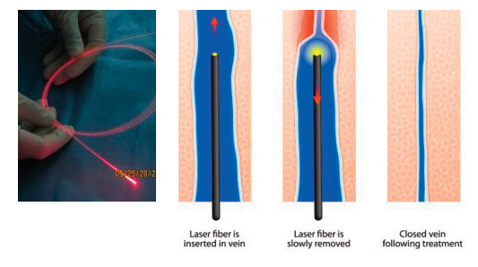
NEWER MODALITIES
Compression sclerotherapy:- Useful in varicose veins less than 3 mm in diameter , below knee varicosity and recurrent varicosity after surgery
US guided foam sclerotherapy:- Polidocanol is used. Sclerosant is mixed with air to make foam.
Endovenous laser ablation:- Vein punctured under US guidance→ guide wire is passed → microsheath is introduced over the guide wire → microsheath is replaced by treatment sheath ,tip is placed 2 cm distal to SF junction→ laser fibre introduced → tumescence anaesthesia injected→ laser is activated→ thermal ablation.

Slide 42
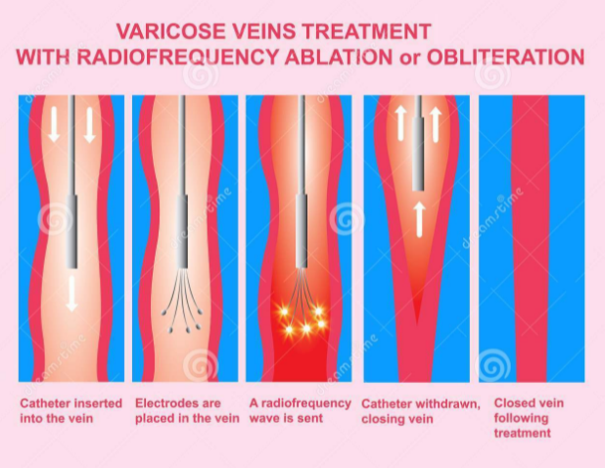
NEWER MODALITIES(Cont.)
Endovenous Radiofrequency ablation:- Radiofrequency catheter (Bernstein) is used. Radiofrequency wave is delivered into vein with a target temperature of 120 ‘ C , the vein walls are compressed by injecting tumescence anaesthesia. The heat generated in the vein causes thermal injury to the vein wall leading to denaturation of matrix protein and eventual fibrotic sealing of the lumen of the vein.
Steam vein sclerosis:- Uses hyper-heated steam to injure the venous endothelial layer causing fibrotic thrombosis .
Glue ablation:- Cyanoacrylate based adhesive when comes to contact with anionic subtances such as blood and polymerizes damaging vascular intima leading to the occlusion of target vesel.

Slide 43
ENDOVENOUS ABLATION

Slide 44
NEWER MODALITIES(Cont.)
Subfascial endoscopic perforator surgery (SEPS):-
Minimally invasive surgery for varicose veins. Perforators are localised by pre-operative duplex scanning and marked in skin surface. Through a small incision videoendoscope is introduced into subfascial plane after CO2 insufflation of subfascial plane. Through additional 5 mm port a endosdissector is introduced and perforators are dissected, ligated and divided under vision.
Sub fascial ligation of Cockett and Dodd:- Perforators are identified deep to deep fascia and ligated subfascially. This is indicated in perforator incompetence with saphenofemoral competence.

Slide 45
Recent updates in management
Mechanochemical endovenous Ablation (MOCA):- Combines mechanical endothelial damage, using a rotating wire, with the infusion of a liquid sclerosant. Tumescence anesthesia is not required. Mechanical portion rotates inside the vein and denudes the endothelium with concurrent injection of sclerosant.
The ClariVein® device is an infusion catheter which is designed to administer a sclerosant in the incompetent vein An iron wire extends through the whole catheter, with a small iron ball at the end. The purpose of the rotating wirer is fourfold: (1) promoting the coagulation activation by minimal mechanical damage to the endothelium, (2) inducing a vasospasm which reduces the diameter of the vein, (3) increasing the action of sclerosant by an increase in surface, (4) ensuring an even distribution of the sclerosant at the endothelium. The catheter together with the iron wire is connected to a motorized handle that allows for the rotation of the metal wire.

Slide 46
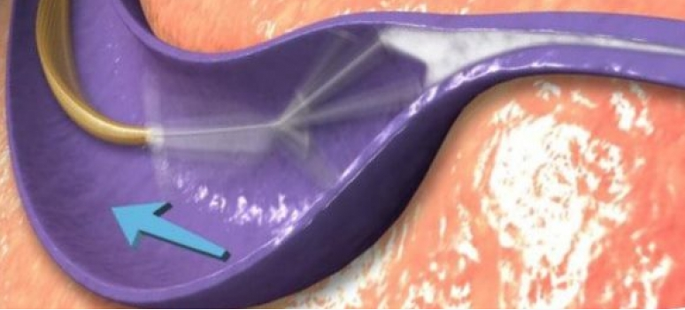
Mechanochemical endovenous Ablation (MOCA)

Slide 47
Transilluminated powered phlebectomy (TIPP)
The Trivex procedure uses a thin lighted wand inserted under the skin to illuminate the veins, while a second minimally invasive instrument is used to remove the problem vein. TriVex can be thought of as "liposuction" of the veins. The TriVex system requires only a few small incisions, through which the surgeon passes a light source that allows visualization of the veins. A scoping device is passed through a second small incision, through which the abnormal veins are removed. It is performed under general or light anesthesia, and patients are discharged the same day and typically require only a brief recovery.

Slide 48
Trivex procedure

Slide 49
The evolution of endovenous radiofrequency ablation (VNUS Closure) of varicose veins
VNUS closure- Under ultrasound control an ablation catheter is inserted into SF junction and slowly withdrawn. It is a new endovenous computer-feedback controlled application of bipolar electrothermal energy which reduces thermal spread to neighbouring tissues. The technique allows patients to enjoy a faster recovery with minimal downtime, little to no scarring, and long-lasting relief from symptoms. According to published studies, over 90 percent of veins treating using VNUS Closure® remained reflux-free 12 to 24 months following the procedure.

Slide 50
VNUS Closure of varicose veins

Slide 52
AMBULATORY PHLEBECTOMY
CHIVA:- CHIVA involves Doppler ultrasonography to assess the hemodynamics Specifically the ultrasound study is to figure out where in the venous system the reflux begins. Then an operation is performed under local anesthesia, consisting of a few incisions and tying off of veins (usually one to four), without venous ablation. The ties are placed according to the ultrasound mapping.
It is a saphenous-sparing therapeutic approach to lower limb chronic venous disease (CVD) based on hemodynamic concepts proposed by Claude Franceschi in 1988.

Slide 53
CHIVA is the French acronym for “Cure conservatrice et Hemodynamique de l’Insuffisance Veineuse en Ambulatoire” (Conservative and Hemodynamic treatment of Venous Insufficiency in the Office).

Slide 54
AMBULATORY PHLEBECTOMY(Cont.)
Müller’s phlebectomy is a simple and minimally invasive surgical technique that allows removal of side branches or small isolated varicose veins (tributary varicose veins) through tiny incisions (2 or 3mm). For small isolated veins it can be carried out under local anesthesia and on an outpatient basis, or it can be used to complement any of the other techniques (stripping, C.H.I.V.A., laser/ radiofrequency…) to remove the collateral branches.

Slide 55
Müller’s phlebectomy

Slide 56
VENOUS ULCER
Introduction:
•Chronic venous disease, including chronic venous insufficiency and chronic venous ulceration, is a common and important medical problem that causes significant morbidity.
Venous ulcers are expensive to treat and adversely impact patient’s quality of life.
•Venous ulcers occur more commonly in the elderly
The peak prevalence occurring between ages 60 and 80 years.
•A venous leg ulcer can develop after a minor injury if there is a problem with the circulation of blood in your leg veins. If this happens, the pressure inside the veins increases.

Slide 57
Risk factors
Obesity – this increases the risk of high pressure in the leg veins
Not being able to move for a long period of time – this can weaken the calf muscles, which can affect circulation in the leg veins
H/O deep vein thrombosis (DVT)– blood clots can damage valves
Varicose veins – swollen and enlarged veins caused by malfunctioning valves
Previous injury to the leg, such as a broken or fractured bone, which may cause DVT
Previous surgery to the leg, such as a hip replacement or knee replacement, which can restrict movement
Increasing age – as mobility is decreased

Slide 58
Pathophysiology
Venous hypertension:
Causes of venous hypertension:
Deep vein thrombosis,
perforator insufficiency
superficial and deep vein insufficiencies
arteriovenous fistulas
calf muscle pump insufficiencies
All these can lead to increased pressure in the distal veins of the leg
and finally venous hypertension

Slide 59
Fibrin cuff theory:
Fibrin gets excessively deposited around capillary beds leading to elevated intravascular pressure.
This causes enlargement of endothelial pores resulting in further increased fibrinogen deposition in the interstitium.
The "fibrin cuff" which surrounds the capillaries in the dermis decreases oxygen permeability 20-fold.
This permeability barrier inhibits diffusion of oxygen and other nutrients, leading to tissue hypoxia causing impaired wound healing.

Slide 60
Inflammatory trap theory:
Various growth factors and inflammatory cells, which get trapped in the fibrin cuff promote severe uncontrolled inflammation in surrounding tissue preventing proper regeneration of wounds.
Leukocytes get trapped in capillaries, releasing proteolytic enzymes and reactive oxygen metabolites, which cause endothelial damage.
These injured capillaries become increasingly permeable to various macromolecules, accentuating fibrin deposition.
Occlusion by leukocytes also causes local ischemia thereby increasing tissue hypoxia and reperfusion damage.

Slide 61
Dysregulation of various cytokines:
Dysregulation of various pro-inflammatory cytokines and growth factors like tumor necrosis factor-α (TNF-α), TGF-β and matrix metalloproteinases lead to chronicity of the ulcers.
Miscellaneous:
Thrombophilic conditions:
Factor V leiden mutation,
Prothrombin mutations,
Deficiency of antithrombin,
Presence of antiphospholipid antibodies,
Protein C and S deficiencies
Hyperhomocysteinemia

Slide 62
Clinical features
Venous leg ulcers are open, often painful, sores in the skin that take more than four to six weeks to heal. They most often develop on the inside of the leg, just above the ankle.
Symptoms:
Swollen ankles (oedema)
Discolouration and darkening of the skin around the ulcer
Hardened skin around the ulcer, which may make the affected leg feel hard and resemble the shape of an upside-down champagne bottle
A heavy feeling in legs
Aching or swelling in legs
Red, flaky, scaly and itchy skin on legs (varicose eczema)
Swollen and enlarged veins on legs (varicose veins)
An unpleasant and foul-smelling discharge from the ulcer

Slide 63
Signs of an infection
A venous leg ulcer can be susceptible to bacterial infection.
Symptoms of an infected leg ulcer can include:
Worsening pain
A green or unpleasant discharge coming from the ulcer
Redness and swelling of the skin around the ulcer
A high temperature (fever)

Slide 64
Examination of leg for venous ulcer
•Palpation of pulses
•Signs of venous disease
Brawny skin
Haemosiderin pigmentation
Varicose eczema
Atrophie blanche (patchy areas of ischemia)
Lipodermatosclerosis
Signs of arterial disease
Shiny, hairless, pale and cool skin

Slide 65
Ulcer examination - describe where possible for every ulcer:
Position
Colour
Tenderness
Temperature
Shape
Size
State of local tissues, including pulses - if cannot feel pulses then use Doppler
Specific to the ulcer:
Base
Edge
Depth
Discharge
Relationship to other structures
Lymph nodes

Slide 66
Surrounding region:
For pain, oedema, erythema, warmth, induration, discoloration, maceration, dryness, scarring from previous wounds, hair pattern, gangrenous digits, clubbing, cyanosis, capillary refill, and varicose veins.

Slide 67
Investigations
The evaluation of patients with venous ulceration primarily includes noninvasive methods to elucidate the distribution and extent of pathology.
Duplex ultrasound is the first line of investigation, as it provides assessment of both reflux and obstruction conditions.
In patients with iliofemoral pathology, axial imaging with computed tomography scan or magnetic resonance imaging should be performed.
If the treatment of iliofemoral vein obstruction is warranted, then invasive assessment using venography and/or intravascular ultrasound should be used to guide the interventional procedure.

Slide 68
Venous valve reflux can be identified and accurately characterized by duplex ultrasound, whereas the ultrasound assessment of functional abnormality associated with obstruction is less reliable.
In patients with ulceration, the evaluation for and treatment of proximal venous obstruction has resulted in improved ulcer healing.

Slide 69
Nonsurgical Treatment
Infected ulcers:
Necessitate treatment of the infection first.
Staphylococcus aureus, Streptococcus pyogenes, and Pseudomonas species are responsible for most infections.
Usually treated with local wound care, wet-to-dry dressings, and oral antibiotics.
Topical antiseptics should be avoided.
Severe infections require intravenous antibiotics.
Leg elevation:
Leg elevation can temporarily decrease edema and should be instituted when swelling occurs.
This should be done before a patient is fitted for stockings or boots.

Slide 70
Compression therapy
Compression therapy is the primary treatment for CVI.
Elastic compression stockings:
Fitted to provide a compression gradient from 30 to 40 mm Hg, with the greatest compression at the ankle.
Donned on arising from bed and removed at bedtime.
Effective in healing ulcers but can take months to obtain good results.
Stockings do not correct the abnormal venous hemodynamics and must be worn after the ulcer has healed to prevent recurrence.
Principal drawback is patient compliance.

Slide 71
Unna boots:
Paste gauze compression dressings that contain zinc oxide, calamine, and glycerin.
Used to help prevent further skin breakdown.
Provide nonelastic compression therapy.
Changed once or twice a week.
Healing time for ulcers is less than that of elastic compression alone.

Slide 72
Pneumatic compression devices:
Provide dynamic sequential compression.
Used primarily in the prevention of deep vein thrombi in hospitalized patients.
Also used successfully to treat venous insufficiency.

Slide 73
Topical medications
Largely ineffective as a stand-alone therapy for venous stasis ulcers
Topical therapy is directed at absorbing wound drainage and avoiding desiccation of the wound
Antiseptics can be counterproductive. Hydrogen peroxide, povidone-iodine, acetic acid, and sodium hypochlorite are toxic to cultured fibroblasts and should be used for the shortest duration necessary to control ulcer infection
Biological dressing
NPWT

Slide 74
Surgical Therapy
Wound debridement
Skin grafting

Slide 75
Diabetic foot

Slide 76
Pathophysiology
Diabetic foot disease involves a complex sequence of changes that lead to the destruction of the foot's function and structure.
Peripheral neuropathy, arthropathy, arterial insufficiency, and infection are the major derangements underlying diabetic foot disease.
The final common pathway is often one of ulceration, gangrene, and limb loss.

Slide 77
Peripheral Neuropathy
Peripheral neuropathy is common among diabetics and is the most difficult component of diabetic foot disease to treat.
Severity ranges from minimal somatosensory changes to total anesthesia with the complete absence of sweating.
Diabetic neuropathy affects the motor, sensory, and autonomic nervous systems, which leads to multiple pathologic conditions.

Slide 78
Destruction of myelinated motor fibers produces a motor polyneuropathy that tends to be bilateral and symmetric.
Attenuation of the Achilles reflex is an early sign of motor neuropathy.
Progression leads to loss of function and atrophy of the lumbricals and intrinsic muscles of the foot.
Unopposed, the extrinsic muscles distort the foot, leading to depression of the metatarsal heads, digital contractures, "clawing" of the toes, and a varus malformation.
These alterations allow pressure points and ulcers to develop over the proximal interphalangeal joints and beneath the metatarsal heads.

Slide 79
Sensory neuropathy involving type A myelinated fibers leads to loss of proprioception, light tough, pressure, and vibration and is noted to develop early.
Compromise of these nerves leads to an ataxic gate and pressure ulceration.
Loss of type C sensory fibers limits a patient's ability to detect painful or noxious stimuli, which contributes to neuroarthropathy, injuries, and the formation of ulcers.
C fibers also participate in nociceptive or neuroinflammatory responses that blunt the signs of trauma and infection in diabetic feet.
Sensory neuropathy can also paradoxically produce pain and paresthesias.
Neuropathic pain can be severe and quite difficult to differentiate from other foot problems.
Diabetic paresthesias are characterized by hyperesthesia, burning, or tingling sensations and tend to resolve over time.

Slide 80
Autonomic neuropathy produces abnormal vasomotor responses. Autosympathectomy increases arteriovenous shunting, which leads to osteopenia.
Hypohidrosis results in dry, cracked skin, which compromises the skin barrier and increases the susceptibility to infections.

Slide 81
Neuroarthropathy
Neuroarthropathy or Charcot's foot is a condition in which
Extensive destruction of the joints occurs within the foot consequent to a loss in muscular stability, osteopenia, and insensitivity to pain.
Most common in diabetics.
Sensory neuropathy permits mechanical insults to go unrecognized by the patient, which produce severe stresses on osteopenic bone.
Bony dissolution and loss of structural integrity follow, leading to collapse of the midfoot arch

Slide 82
Minor foot trauma (e.g., minor fracture, sprain, and contusion) often catalyzes neuropathic skeletal changes.
Localized warmth and swelling at the site occur initially; this is usually nontender and out of proportion to the injury.
The warmth and swelling of this inflammatory stage of neuropathic osteoarthropathy can be difficult to distinguish from infection.
Chronically, skeletal encroachment occurs in the tarsometatarsal and metatarsophalangeal joints followed by collapse of the arch.
Subluxation or even lateral dislocation of the forefoot occurs, producing a bowed, "rocker-bottom" foot, which is extremely susceptible to ulceration.

Slide 83
Arterial Insufficiency
Altered glucose metabolism in diabetics leads to changes in response to endothelial injury, dyslipidemia, enhanced platelet activity, and increased blood viscosity.
These factors contribute to an increased incidence of atherosclerotic occlusive disease and hypercoagulability in diabetic patients.
Arterial insufficiency contributes to the development of neuropathy, limits a patient's ability to heal ulcers and traumatic injuries, and in the worst case, produces ischemic ulcers.

Slide 84
The distribution of atherosclerotic disease in diabetics typically involves the femoropopliteal and tibial vessels with relative sparing of aortoiliac and pedal vessels.
Consequently, femoral to distal tibial or pedal bypasses are feasible for limb salvage in many diabetics with critical ischemia.

Slide 85
Infection
Diabetic foot infections range from superficial cellulitis to wet gangrene and abscess formation.
Peripheral neuropathy and neglected skin lesions or ulcers often initiate deep-space infections.
Fungal infections contribute to ulceration and secondary bacterial infection either by direct microscopic breaks in the skin or through toenail loss.
Loss of proprioception facilitates traumatic injury.
Arterial insufficiency and the diminished inflammatory response allow for rapid progression of an infection.
The hallmark of diabetic foot infections is a polymicrobial infection.
Gram-positive species, including streptococci, staphylococci, enterococci, and gram-negative anaerobes are present.

Slide 86
Assessment
Assessment of the patient with diabetic foot disease begins with a thorough history with attention given to the presence of cardiac disease, renal disease, peripheral vascular disease, smoking history, and habits of foot care.
Laboratory studies include a basic chemistry, a complete blood cell count, a hemoglobin A1c concentration, and a urinalysis.
A comprehensive physical examination with emphasis on the neurologic and vascular function of the lower extremities is essential.

Slide 87
The feet should be carefully examined for capillary refill, nail thickening, ulcers or ischemic lesions, signs of infection, intrinsic muscle wasting, bony prominences, and evidence of tenderness.
Ischemic ulcers tend to occur in the toes, whereas neuropathic ulcers present over bony prominences and the heel in patients who are bed bound.
Gentle probing of ulcers to determine whether there is palpable bone at the base is encouraged as a highly specific and accurate test for the detection of osteomyelitis.

Slide 88
Superficial wound cultures are of little utility.
Pulse assessment of the femoral, popliteal, dorsalis pedis, and posterior tibial arteries should be performed.
In the absence of palpable pulses, a continuous-wave Doppler probe should be used to assess for the presence of signals.

Slide 89
Noninvasive laboratory studies are often helpful in assessing the degree of vascular insufficiency and predicting healing potential
Studies may include segmental limb pressures with Doppler waveforms, calculation of ankle-brachial indices, and toe pressures
Any gradient greater than 30 mm Hg between any level indicates the presence of a high-grade stenosis or occlusion
Calcification within the arterial wall often renders diabetic vessels incompressible and waveform interpretation must be used to identify disease
In diabetics, toe or partial foot amputations require ankle pressures of at least 55 mm Hg and toe pressures of at least 30 mm Hg to heal
Transcutaneous oxygen measurements may also predict healing if there is at least a pressure of 30 mm Hg

Slide 90
Imaging
Plain radiographs are useful in the assessment of the diabetic foot.
It can identify
soft tissue calcifications,
gas from bacterial infections,
the presence of foreign bodies
fractures.
Plain radiographs can detect osteomyelitis but are most sensitive in the later stages when bony destruction has occurred.
Three-phase bone scans are highly sensitive for osteomyelitis except in the presence of severe vascular disease.

Slide 91
Arteriography is required when foot perfusion appears inadequate and arterial reconstruction is planned.
The location and degree of occlusive disease are readily assessed with arteriography.
Assessment of the outflow vessels and, in particular, communication of the pedal vessels with the pedal arch is also important.
Magnetic resonance angiography (MRA) is highly accurate in the detection of large-vessel disease and is useful in patients who are intolerant of contrast dyes.

Slide 92
Magnetic resonance imaging (MRI) of the diabetic foot provides unparalleled imaging of the soft tissues.
Contrast-enhanced sequences can be used to determine the extent of osseous and soft tissue infection and can delineate areas of ischemia or necrosis.

Slide 93
Prevention
Prevention of ulceration is imperative to prevent limb loss.
Every diabetic patient should have an annual foot examination by a physician and, if the patient has neuropathy, at every visit with a health care professional.
Self-examinations should occur daily.
Hyperglycemia should be controlled to slow the development of neuropathy.

Slide 94
Management
Optimal treatment of diabetic patients requires a comprehensive program involving –
control of hyperglycemia,
foot protection,
timely treatment of ulcers, osteoarthropathy and infections.
Diabetics with high-risk foot conditions benefit from education regarding risk factors and their appropriate management.

Slide 95
The risk of ulceration is increased in diabetic patients
with longstanding diabetes,
male gender,
poor glucose control,
neuropathy,
presence of vascular, renal, or cardiac disease complications of diabetes.
Patients with signs of increased plantar pressure such as erythema, warmth, or callus formation should use protective footwear that cushions and redistributes weight appropriately.
Nonambulatory or bed-bound patients should also have their feet protected; the Rooke boot is a sheepskin and foam boot that is ideal for this purpose (Osbourne Medical, Rochester, Minn.).
Calluses should be débrided by a specialist.
Dryness and fungal infections should be treated appropriately with petroleum-based products (e.g., Aquaphor ointment) and topical antifungals, respectively.

Slide 96
Neuropathic Ulcers
Diabetic foot ulcerations fall into two main categories, ischemic and neuropathic, with some overlap between.
In about 30% of patients with plantar neuropathic ulcerations, ischemia will prolong healing times.
Vascular assessment is always required to ascertain the presence of coexisting occlusive disease.
Even with adequate arterial inflow, neuropathic ulcers may remain unchanged for months secondary to impaired inflammatory and healing responses.
These ulcers are subject to the constant risk of infection, and prolonged ulcer healing lengthens the exposure to this risk.
Infection requires prompt management when it arises.
The extent and anatomic site of neuropathic ulcers direct their management.
They are most commonly located beneath one of the metatarsal heads or the interphalangeal joint of the hallux.
Aggressive débridement is essential in establishing the depth of the ulcer. This requires removal of excessive callus and all necrotic debris.
Daily wound care minimizes the risk of infection.

Slide 97
Protecting the weightbearing surface of the foot and offloading mechanical stress is paramount in the treatment of neuropathic ulcers not associated with ischemia.
Nonweightbearing for 6 to 12 weeks is an ideal, though poorly tolerated, method to promote healing.
An alternative treatment is total contact casting (TCC), which uses a protective short leg cast to mechanically offload the foot at the ulcer site and control edema while allowing some degree of ambulation.
TCC results in healing of 70% to 100% of neuropathic plantar ulcers within 5 to 8 weeks.

Slide 98
Neuropathic ulcers 3 cm or less in diameter can be treated with TCC unless severe ischemia, deep ulceration, infection, or significant edema is present.
TCC is generally well tolerated and complications infrequently occur from inadequate padding of bony prominences, cast friction, or skin irritation.
Specialized shoes with arch bars or formed orthotic insoles are another method to redistribute pressure evenly across the plantar foot.

Slide 99
Once the ulcer is healed, the foot must be continually protected in appropriate footwear.
In the diabetic foot, all calluses should be considered preulcerative and should not be mistaken as "benign."
Calluses signify areas of repetitive trauma over bony prominences due to vertical, shear, and compressive forces.
Calluses should be reduced, bony prominences padded or relieved, and skin lotion used after bathing the feet once or twice daily, drying well between the toes.
Antibiotics are used in neuropathic and ischemic foot ulcers only in the presence of cellulitis, abscess, osteomyelitis or pyoarthrosis.

Slide 100
Ischemic Ulcers and Gangrene
Gangrene and ischemic ulcers are common complications with which surgeons are confronted
Aggressive arterial reconstruction has been paramount in reducing amputation rates over the past several decades.
With current techniques, 90% of diabetics presenting with ischemic ulceration or gangrene are found to have surgically correctable occlusive disease.
Vascular reconstruction in diabetic patients typically involves bypass from the femoral or popliteal arteries to tibial, peroneal, or pedal vessels.
In the absence of continuous tibial vessels, a bypass to a patent pedal vessel or a peroneal artery with good ankle collaterals is a reasonable option.
Autologous vein should be used whenever possible because synthetic grafting to infrageniculate vessels has poor long-term patency.
Primary patency rates of 80% at 1 year and limb-salvage rates of 92% at 3 years are achievable.
Although endovascular treatment of flow-limiting arterial stenoses and occlusions has not achieved the long-term patency of distal bypass with autologous vein grafts, this modality is effective in short-term improvements in circulation. Endovascular therapy may be preferable in patients unable or unwilling to undergo traditional bypass.

Slide 101
Invasive Foot Infection
Infection often originates in areas of recent trauma or chronic ulceration and may progress rapidly to acute foot sepsis. The initial management is directed at resuscitation and control of the foot infection.
Initial broad-spectrum antibiotics should be administered and refined based on culture and sensitivity data.
Partial foot amputations may be warranted to control sepsis.
These amputations are left open, and are designed to remove large areas of devitalized tissue, destroyed bones, and septic joints.
Careful consideration must be given to preserve as much functional tissue as possible.
Guillotine amputation at or above the ankle is required when infection extends proximal to the midfoot and is associated with hindfoot ischemia.
Definitive amputation follows when infection has been controlled and metabolic derangements improve.
•Drainage and débridement of necrotic tissues are the primary goals in invasive diabetic foot infections with revascularization delayed until the infection has been controlled.
•Diabetic foot infections are often much more extensive than assumed given the propensity of infection to track along the tendon and fascial sheaths.
•Wound and sinus tracts should be opened to permit free drainage; involved bone or joints should be resected.
•Subsequent procedures may be necessary to ensure adequate drainage.
•Deep cultures of the wound should be obtained.

Slide 102
Amputation
Amputations are indicated for removal of gangrenous or necrotic tissue.
The level of amputation depends on the proximal extent of the disease and the degree of vascular insufficiency.
With normal circulation, amputation can usually be performed just proximal to the extent of the necrotic tissue.
Distal toe ulcers will often slough once revascularization has occurred and should be followed for several months before amputation is offered.
Although some allow dry gangrenous digits to autoamputate, button or ray amputations are preferable to spare the discomfort and distress autoamputations can cause patients.
Resection of the distal metatarsal head and removal of all cartilage and sesamoid bones are essential maneuvers in the performance of ray amputations.

Slide 103
A transmetatarsal amputation is considered if multiple toes or the distal forefoot is involved.
A transmetatarsal amputation is inadequate in the presence of the midplantar foot ischemia, especially if the medial two or lateral three rays must be sacrificed. In this scenario, midfoot or hindfoot amputations (e.g., Chopart's) along with the appropriate tenotomies may be considered.
Even if successful, however, hindfoot amputations leave patients with a "peg leg," which may not be as functional as a below-knee amputation.
If ischemic disease or infection involves the proximal foot, a below-knee amputation is indicated in the ambulatory patient.

Slide 104
Furthermore, in the presence of extensive neuropathic osteoarthropathy involving the tarsal bones with total collapse of the midfoot, a below-knee amputation may be preferable to extensive attempts at reconstruction.
Above-knee amputations may be appropriate in chronically nonambulatory patients, patients with fixed knee contractures, or patients with marginal, unreconstructible, distal circulation.

Slide 105
Adjunctive Therapies
Despite good wound care, adequate offloading, and treatment of infection, diabetic foot ulcers will occasionally be recalcitrant to standard care.
Several therapies exist to improve wound healing, including hyperbaric oxygen therapy, platelet-derived growth factors, bioengineered skin and dermal substitutes, granulocyte colony-stimulating factor, and vacuum-assisted dressings.
Vacuum-assisted dressings (VAC; Kinetic Concepts, Inc., San Antonio, Texas) have been particularly useful in stimulating reepithelialization and granulation tissue formation and are well tolerated by patients

